Slide 1
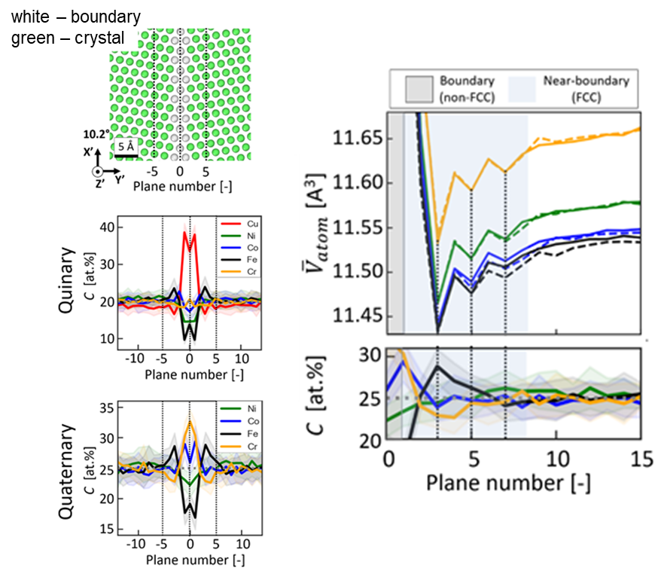
Large variations in structure and chemistry in the near-boundary region
2021 IRG-1 Intellectual Merit
DMR-2011967, MRSEC
MJ McCarthy, D Apelian, WJ Bowman, H Hahn, X Pan, TJ Rupert, University of California, Irvine
J Luo, SP Ong, University of California, San Diego
Grain boundaries, interfaces between two crystals inside a material, are important defects which can dramatically alter material response because the structure of the boundary is different from the bulk crystalline region.
Using a unique set of metals called multi-principal element alloys (MPEAs), IRG-1 has shown that grain boundaries can have multiple levels of local structural and chemical heterogeneities that far surpass what was previously hypothesized. Not only does the boundary itself serve as a sink for dopants due to the local defects, but a thicker, near-boundary region has reduced free volume compared to the bulk and can be enriched in other atomic elements.
While the team discovered these unique near-boundary regions in MPEAs, they have shown that these features exist in simpler materials too, opening the door for a new yet widely-applicable materials design concept.
Near-boundary regions have unique structures and chemistries.

